Slide 1
Deep Reinforcement Learning for UAVs in Coverage Missions
TRABALHO DE GRADUAÇÃO 1
AUTHOR: NICHOLAS SCHARAN CYSNE
ADVISOR: CARLOS HENRIQUE COSTA RIBEIRO
INSTITUTO TECNOLÓGICO DE AERONÁUTICA

Slide 2
Summary
01.
02.
03.
04.
Introduction
Objective
Literature Review
Methodology

Slide 3
Introduction

Slide 4
“
A group of relatively unsophisticated robots can form a networked team that realizes a range of behaviors well beyond the capabilities of the individuals by communicating and cooperating with team members.
____
The Grand Challenges of Science Robotics
Yang et al, 2018
Motivation
Applications
Drones can perform missions of exploration and reconnaissance in dangerous or extreme condition environments, after disaster events, in inhospitable settings or in military operations.
4

Slide 5
Contextualization
Reinforcement Learning in network topologies
for coverage missions
Most of what is attributed to multi-agent systems eventual success is the existence of robust network topologies
Network explores a region, avoiding obstacles while maintaining connectivity and communicating possible points of interest
Key characteristics
Ad Hoc networks susceptible to enemy attacks
Area Coverage
Connectivity Maintenance
Obstacle Avoidance
Robustness Maintenance
5

Slide 6
Objective

Slide 7
Main Objective
To train an agent that is capable of cooperation with replicas of itself to create a network topology able to perform coverage missions
Milestones
Train an agent that moves to target location with obstacles avoidance⁽¹⁾
Train a small group of agents that executes (1) while performs:
Objective of this Work
Area Coverage
Connectivity Maintenance
Robustness Maintenance
Gradual increase of number of agents in the network
7

Slide 8
Literature Review

Slide 9
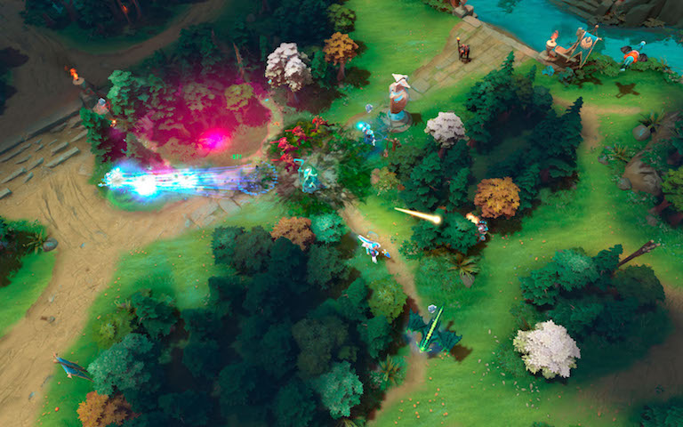
Previous Works
Developments in Deep Reinforcement Learning
and Network Topologies
Ghedini et al. (2018) proposes a combination of control laws that takes into account each objective of the network
Minelli et al. (2018) proposes an online optimization of weights for the control laws devised by Ghedini et al.
Several developments in model-free RL, such as Deep Q-Learning and PPO
Most researches are in competitive settings
Gupta and Nallanthighal (2021), propose a Deep RL framework for network topologies
Cooperative AI research communication, commitment, and trust between agents
9
OpenAI. Open AI Five. https://openai.com/blog/openai-five/

Slide 10
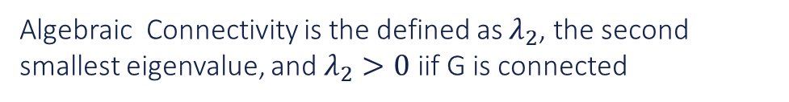
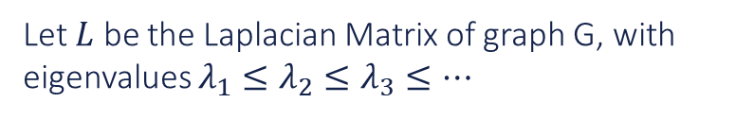
Algebraic Connectivity
Measure of connectivity in a graph G
Network
Topologies
Let $L$ be the Laplacian Matrix of graph G, with eigenvalues $λ_{1}≤λ_{2}≤λ_{3}≤…$
Algebraic Connectivity is the defined as $λ_{2}$, the second smallest eigenvalue, and $λ_{2}>0$ iif G is connected
10
Godsil, C. & Royle, G. Algebraic Graph Theory. 2001.

Slide 11
Betweenness Centrality
Robustness of a Network
A measure of influence a node has in a graph, regarding the flow of information through nodes
Locate essential nodes for the flow on information passes from one part of a graph to another
Ability to withstand failures and perturbations
In network topologies, attacks directed to nodes with high ranking of BC are likely to prejudice the network connectivity
11
Godsil, C. & Royle, G. Algebraic Graph Theory. 2001.

Slide 12
“
Intelligence measures an agent’s ability to achieve goals in a wide range of environments
____
Universal Intelligence: A Definition of Machine Intelligence,
Legg & Hunter, 2007
What is Intelligence?
Questions
How to achieve it?
How to measure it?
12

Slide 13
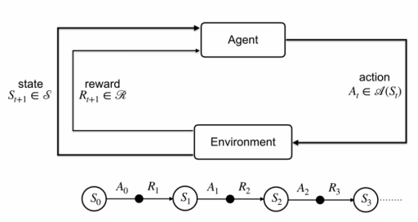
Reinforcement Learning
General Purpose Framework for AI
Agent interacts with an environment through actions
Balances short and long-term rewards to maximize long-term return
13
Sutton & Barto. Reinforcement Learning: An Introduction. 2018.

Slide 14
Why use Reinforcement Learning?
01.
02.
03.
04.
Don’t need to model the entire system, just a reinforcement signal
Capable of generating complex behaviors and strategies without prior knowledge
Learning on environments with non-stationary characteristics
Intuitive framework based on how we human beings or other animals learn
14

Slide 15
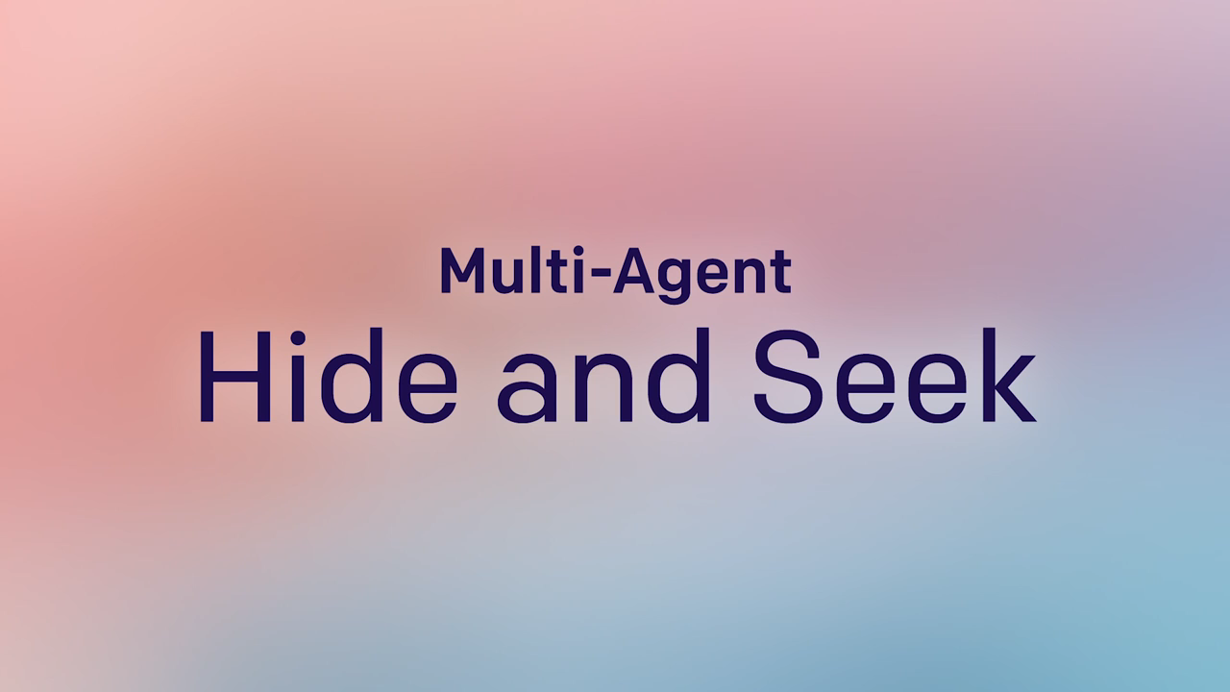
Case Study: OpenAI Hide and Seek
Deep Reinforcement Learning can now learn to play complex multi-player games at human level
Use procedurally generated environments to produce robust, generalizable behaviors
Agent policies are trained with Self-Play and PPO
15
Open AI. Emergent Tools Use from Multi-Agent Interaction. 2019

Slide 16
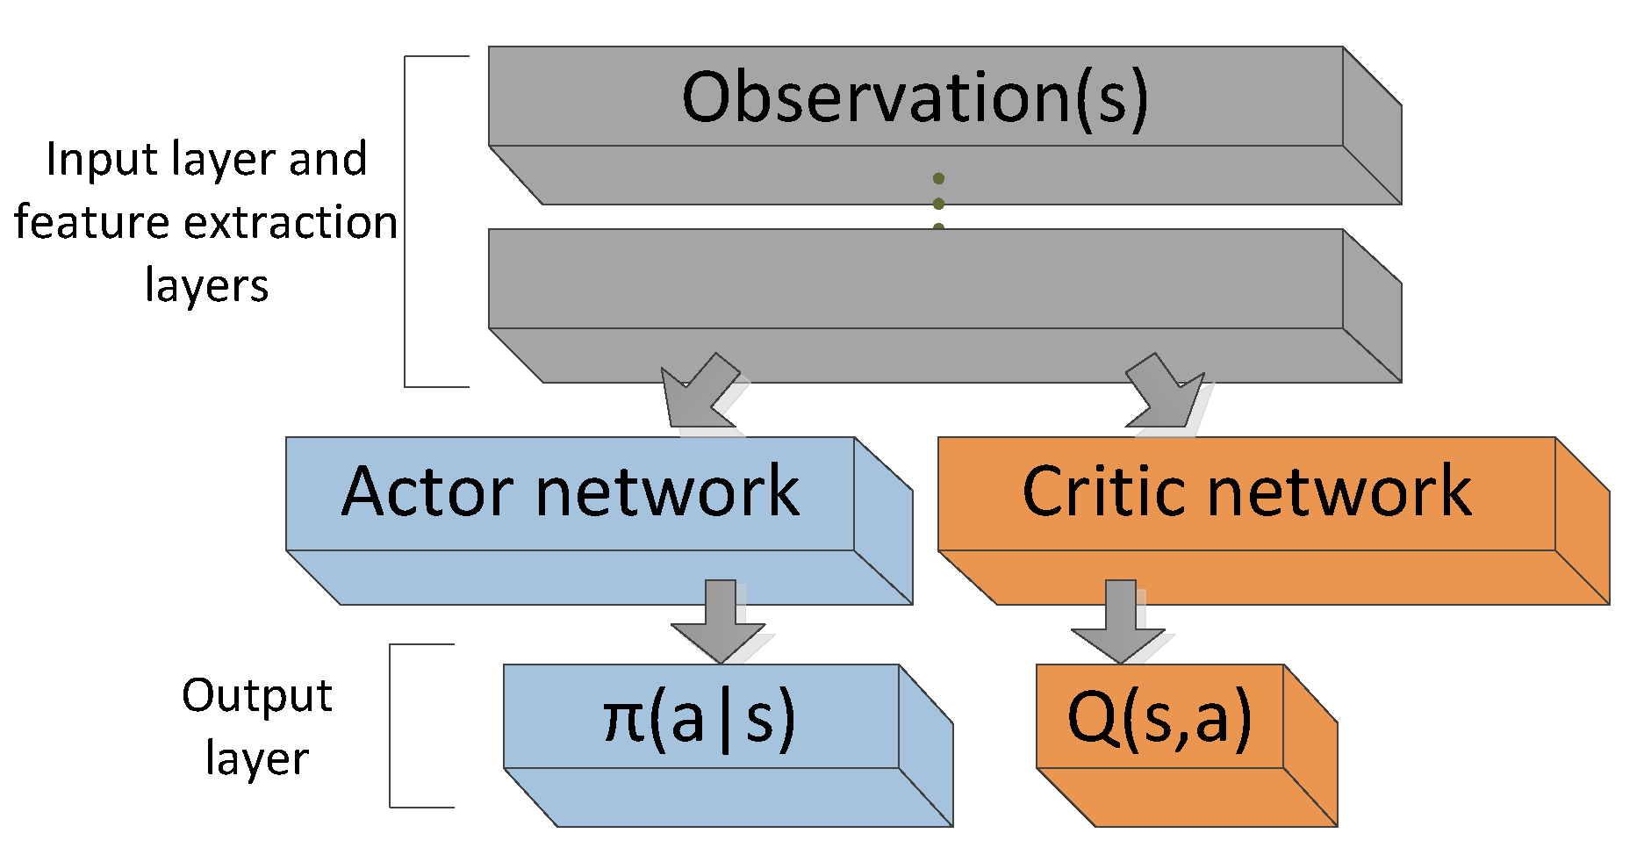
Actor-Critic Architecture
Actor-
Critic
Methods
Actor: suggests actions given the current state
Critic: calculates Q-value for the last <state, action> pair
16
Sutton & Barto. Reinforcement Learning: An Introduction. 2018.

Slide 17
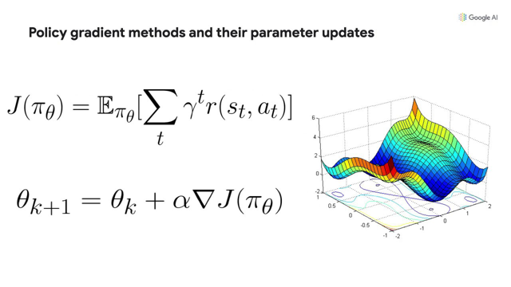
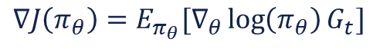
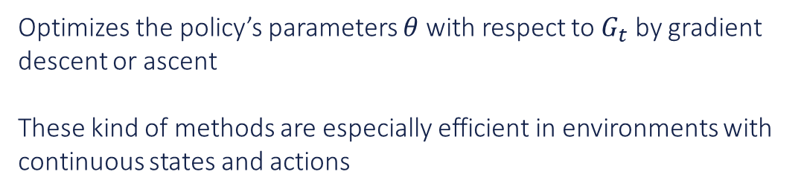
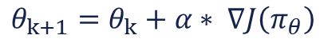
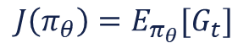
Optimizes Neural Network parameters $θ$
Optimizes the policy’s parameters $θ$ with respect to $G_{t}$ by gradient descent or ascent
These kind of methods are especially efficient in environments with continuous states and actions
Policy Gradient
Methods
$$θ_{k+1}=θ_{k}+α∗ ∇J\left(π_{θ}\right)$$
$$J\left(π_{θ}\right)=E_{π_{θ}}[G_{t}]$$
$$∇J\left(π_{θ}\right)=E_{π_{θ}}[∇_{θ}\log\left(π_{θ}\right)G_{t}]$$
17
Sutton & Barto. Reinforcement Learning: An Introduction. 2018.

Slide 18
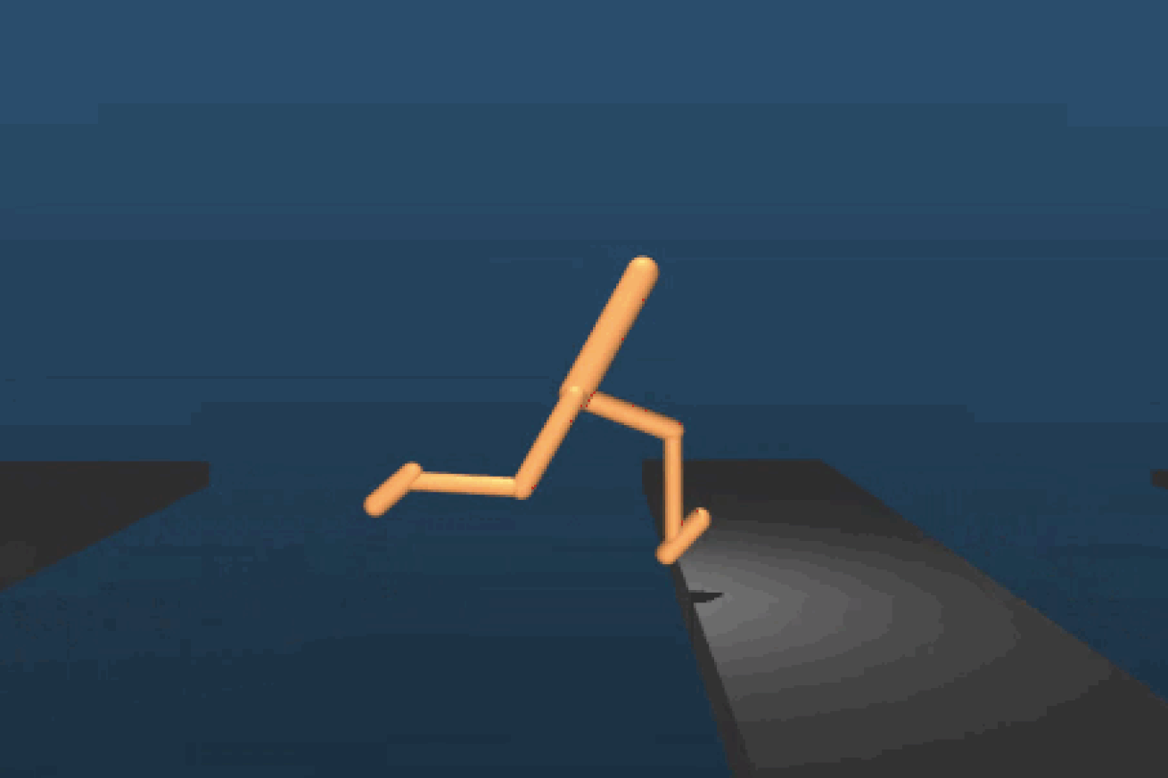
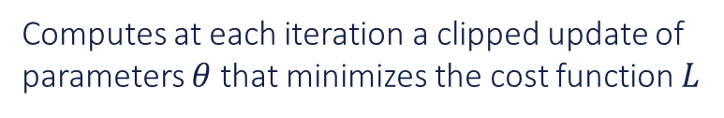
Proximal Policy Optimization
Policy gradient algorithms are extremely sensitive to the learning rate
On-line policy algorithm
Computes at each iteration a clipped update of parameters $θ$ that minimizes the cost function $L$
$$L^{CLIP}\left(θ\right)=E_{π,θ}[min⁡(r_{t}\left(θ^{′}\right)A_{w}, clip(r_{t}\left(θ^{′}\right)A_{w},1−ε,1+ε))]$$
18
Schulman, Wolski, Shariwal, Radford & Klimov. Proximal policy optimization algorithms. 2017.

Slide 19
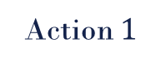
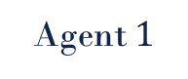



Naïve Parameters Sharing
DNN
Agent $1$
state 1
Action $1$
parameters $θ$
Agent 2
state 2
Action 2
parameters $θ$
…
Multi-Agent
Reinforcement
Learning
…
Agent N
state N
Action N
parameters $θ$
Common approach where agents have similar tasks and expected behaviors
Every agent contributes to parameters update during training
19

Slide 20
Multi-Agent Deep Stochastic Policy Gradient
Centralized Training and Decentralized Execution (CTDE) Algorithm for MARL
Centralized Training
Decentralized Execution
Christianos, Papoudakis, Rahman and Albrecht.
Scaling multi-agent reinforcement learning with selective parameter sharing. 2021.
20

Slide 21
Methodology

Slide 22
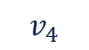
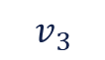
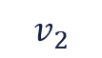
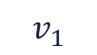
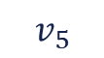
Example
$$v_{4}$$
$$v_{5}$$
$$v_{3}$$
$$v_{1}$$
$$v_{2}$$
Problem
Modeling
$v_{i}∈V(G)$ represents a drone in the network
$e_{ij}∈E(G)$ represents an interaction between drones $i$ and $j$
Modeling of the problem as a MDP, $(S, A, P, R, γ)$
Input of the DNN will be the agent state and the output will be its action
22

Slide 23
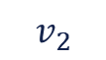
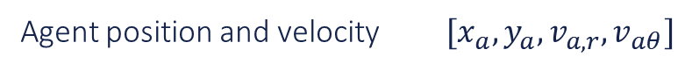

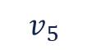
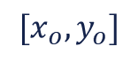
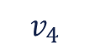
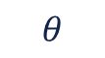
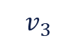
Problem Modeling
Modeling agent’s behavior as a Markov Decision Process
State Space - Input
Agent position and velocity $[x_{a},y_{a},v_{a,r},v_{aθ}]$
$$v_{4}$$
$$v_{5}$$
Position of neighbors in range $[x_{n},y_{n}]$
Position of obstacles in range
$$[x_{o},y_{o}]$$
$$θ$$
$$v_{3}$$
$$v_{1}$$
Action Space - Output
$$v_{2}$$
Velocity of agent: $[v_{a,r},v_{aθ}]$
Reward functions to be defined
23

Slide 24

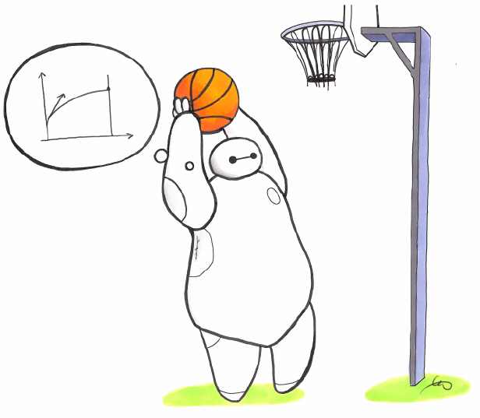
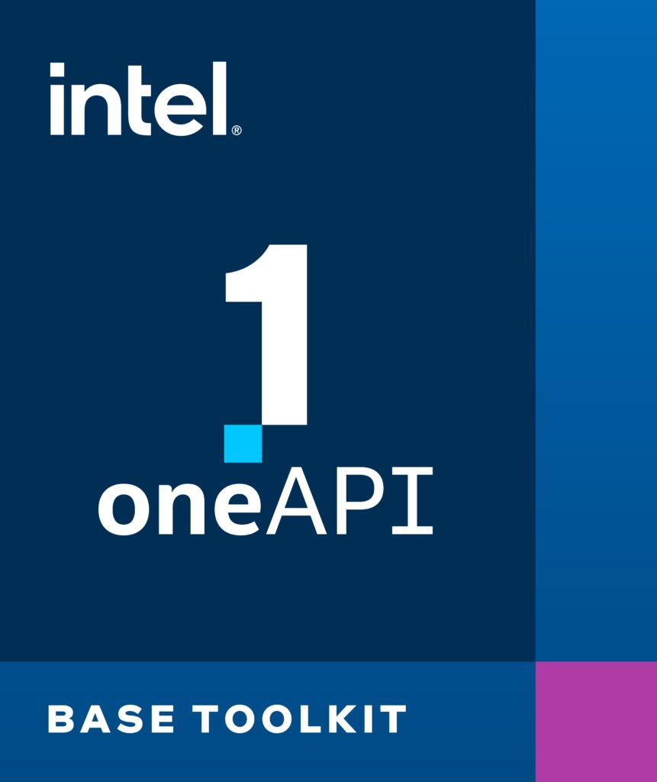
PyGame
Creation of a simulator using PyGame library for Python for visualization of training and evaluation of episodes
Stable Baselines
Branch of Open AI’s Baselines, Stable Baselines will be used for the implementation of PPO and MADSPG
Tools and Frameworks
Intel® DevCloud for oneAPI
Platform to develop and train machine learning models on powerful clusters of machines.
24

Slide 25

1. Move to Target Location with Obstacle Avoidance
Characteristics
Training
Only 1 Agent
Random generated scenario (number, position)
Start at $x=0$, target at $x=X_{target}$
25

Slide 26
Training
Separate training in specific tasks with small networks of 3 or more agents
2.a. Area Coverage
2.b. Connectivity Maintenance
2.c. Robustness Maintenance
Minimize intersection
of areas
Maintain high connectivity
(high proximity)
Avoid bridge nodes in the network
26

Slide 27
Training
Increase complexity of the network
3. Gradual Increase in number of agents
N
Generate more complex behaviors in the network
7
5
Maximum number will depend on time available
3
…
Larger the N, the better
# Agents
27

Slide 28
Plan of Action
Activity
Deadline
Jun
Jul
Aug
Sep
Oct
Nov
Modeling of the problem as an MDP
15/Jul
Define reward functions of each task
29/Jul
Define DNN architecture
29/Jul
Design simulator and start training
12/Aug
Present results for Task 1
26/Aug
Present results for Task 2
23/Sep
Present results for Task 3
21/Oct
Wrap up and writing of TG-2
-
28

Slide 29
Thank You & Questions

